Slide 1

Natural Language Processing
This Photo by Unknown Author is licensed under CC BY-SA-NC
Retail and ecommerce

Slide 2
Project Objective
The main objective of this project is to perform sentiment analysis on customer reviews from an eCommerce platform and build a classification model to predict the sentiment. The goal is to understand customer opinions and experiences with a specific product, which can help in making informed business decisions. The final results will be deployed using Streamlit for easy access and visualization.

Slide 3
Purpose of the Project
Analyze Customer Sentiment: Identify whether customer reviews express positive, negative, or neutral sentiments. This insight can guide product improvements, marketing strategies, and customer service enhancements.
Build a Predictive Model: Develop a machine learning model that can automatically classify the sentiment of new customer reviews. This model can be integrated into a broader eCommerce platform to monitor customer feedback in real-time.
Deploy the Model: Make the results accessible through a Streamlit application, enabling stakeholders to interact with the model and explore the sentiment analysis results in a user-friendly interface.

Slide 4
Dataset Summary
The dataset contains 5,600 customer reviews related to the "Apple 20W USB-C Power Adapter." It consists of the following four columns:
Product Title: The title of the product is reviewed. (All reviews are from the same product “Apple 20W USB-C power adapter”.)
Review Title: The title of the review, often summarizing the customer’s setiments or key opinion.
Rating: A textual representation of the rating given by the customers.
Review Body: The detailed content of the review where the customers express their opinions and experiences.

Slide 5
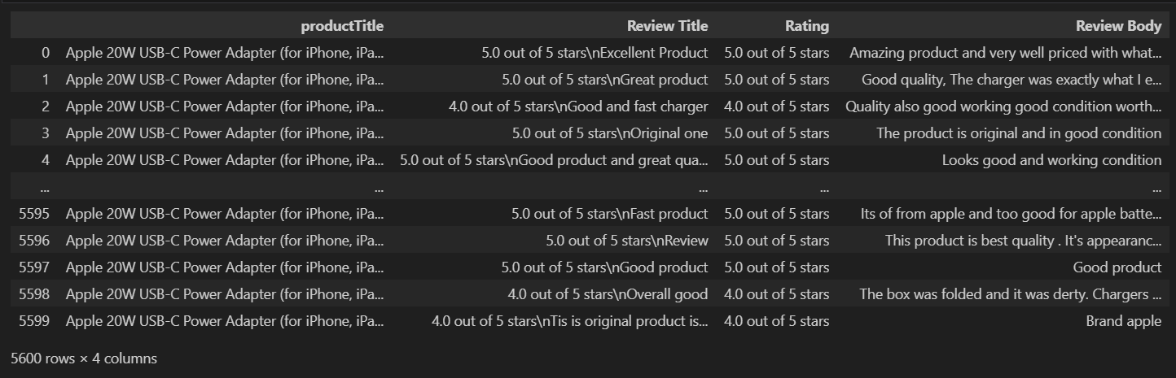
Dataset

Slide 6
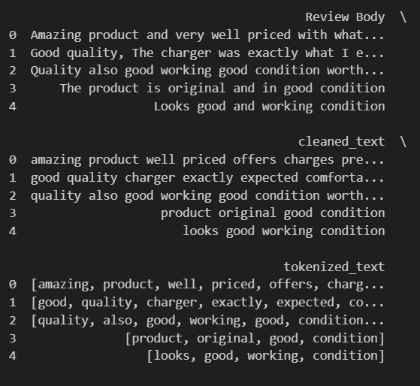
Cleaned data

Slide 7
Sentiment Analysis

Slide 8
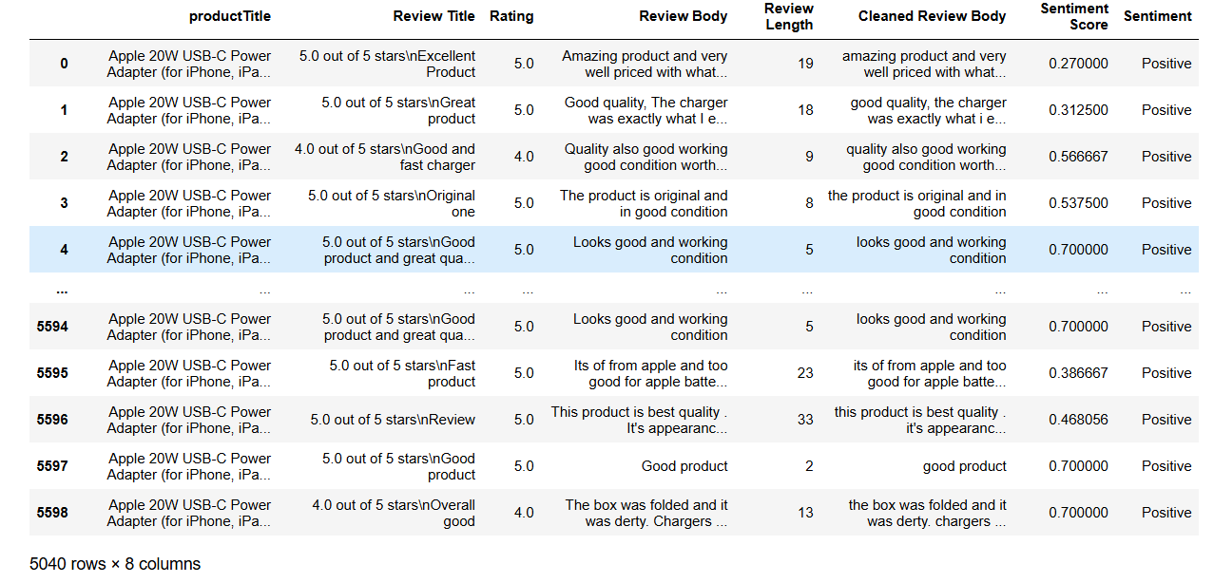
Positive Reviews

Slide 9
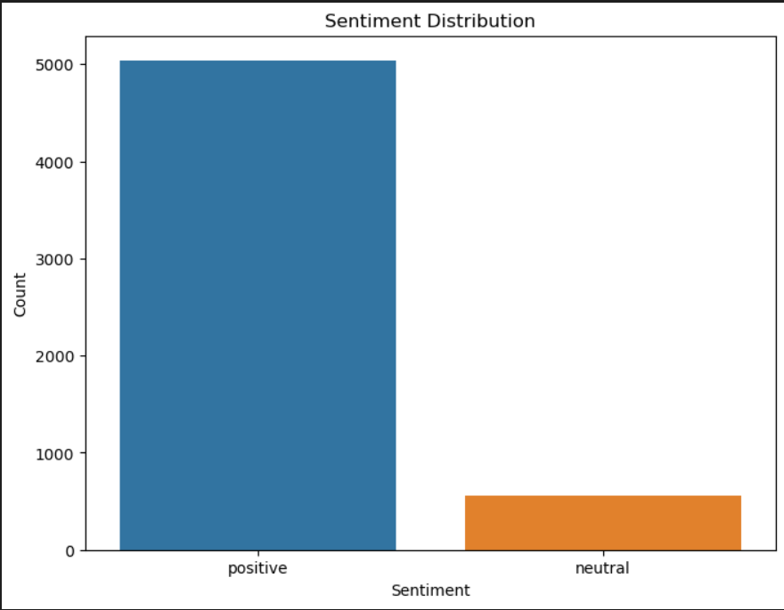
Sentiment Distribution

Slide 10
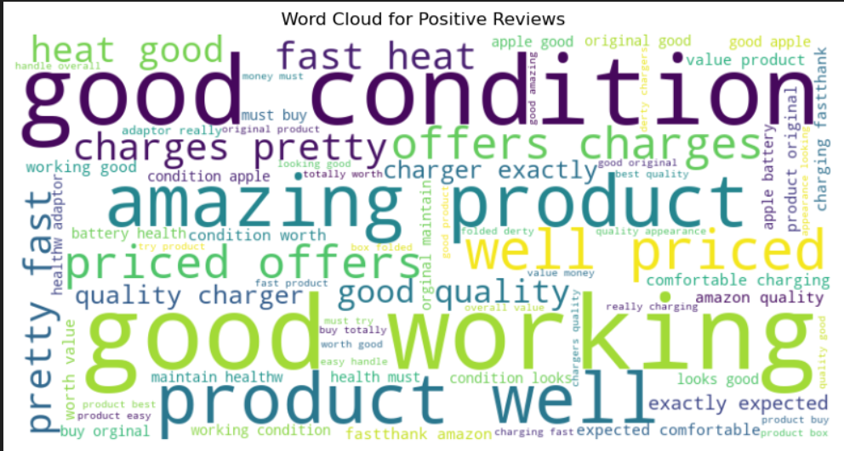
Positive Word Cloud

Slide 11
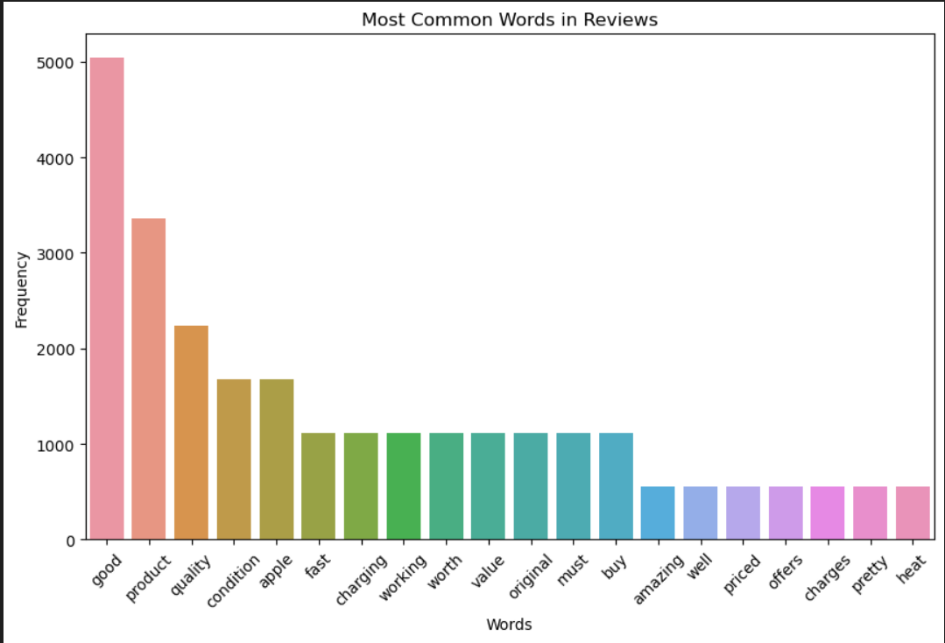
Most Common Words In Reviews

Slide 12
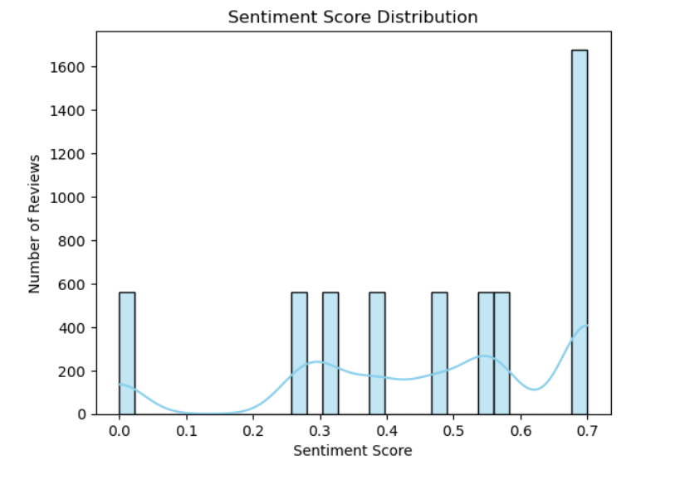
Sentiment Score Distribution

Slide 13
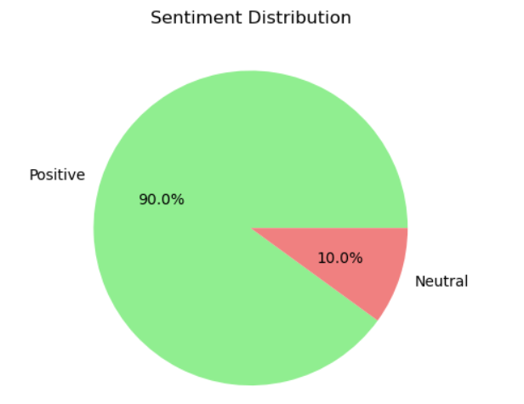
Analyse the sentiment distribution

Slide 14
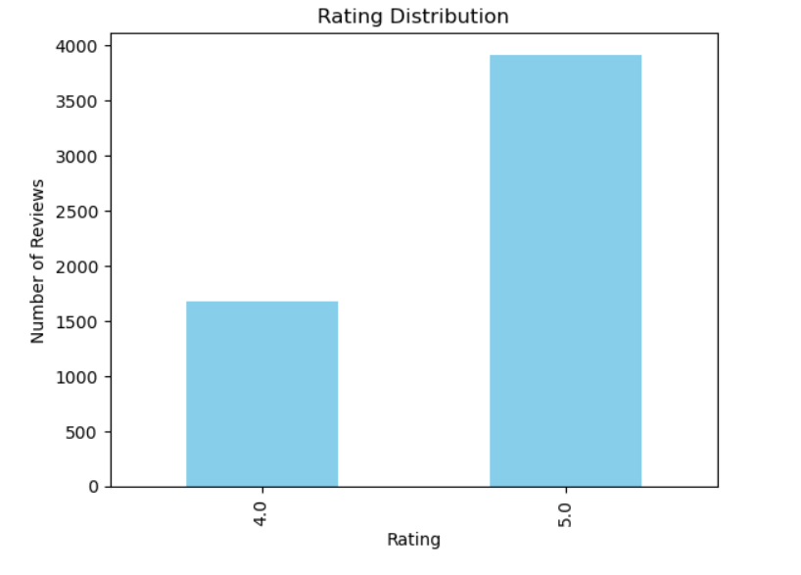
Rating Distribution

Slide 15
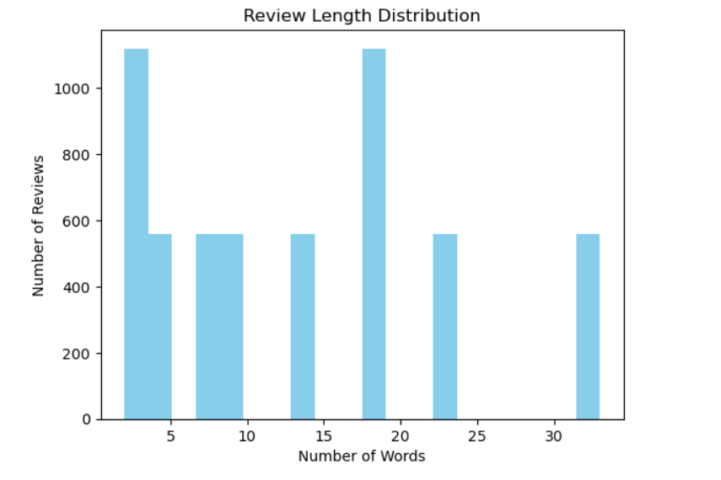
Review Length Distribution

Slide 16
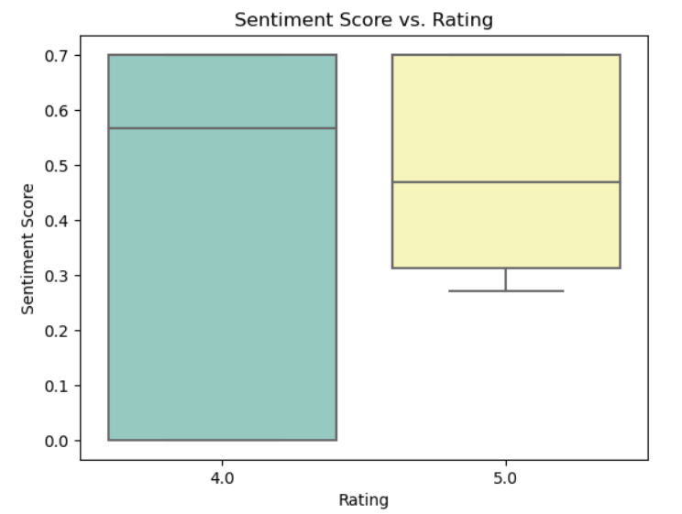
Box Plot

Slide 17
Model building

Slide 18
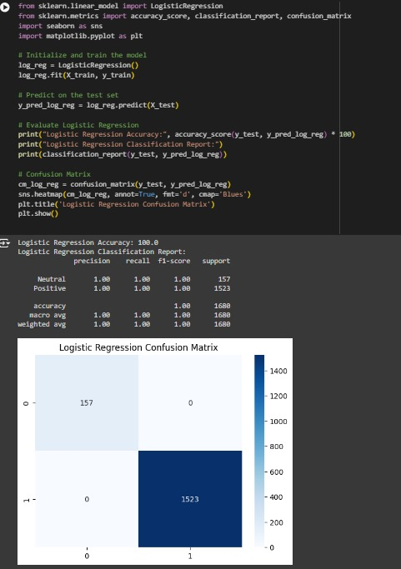
Logistic Regression

Slide 19
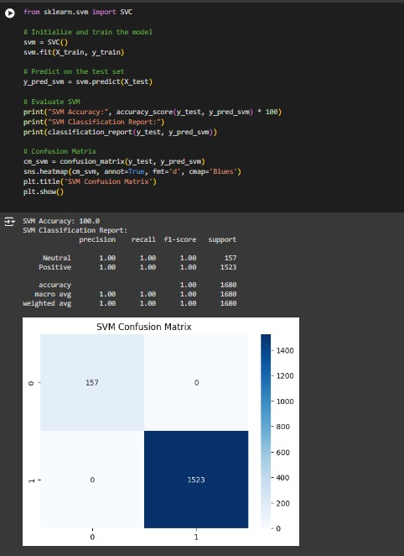
SVM

Slide 20
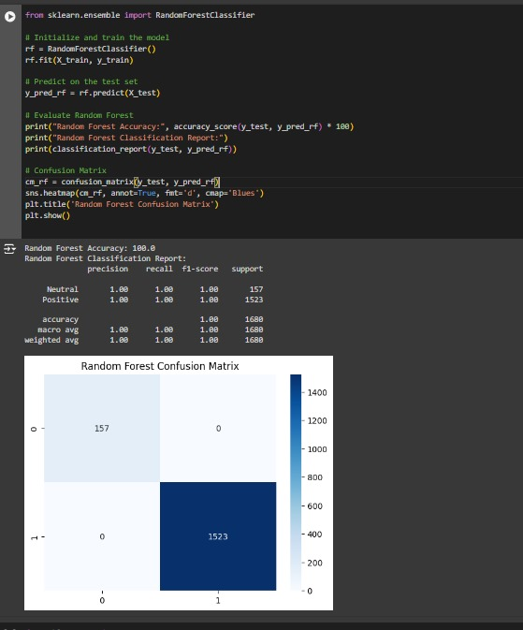
Random forest

Slide 21
Deployment

Slide 22
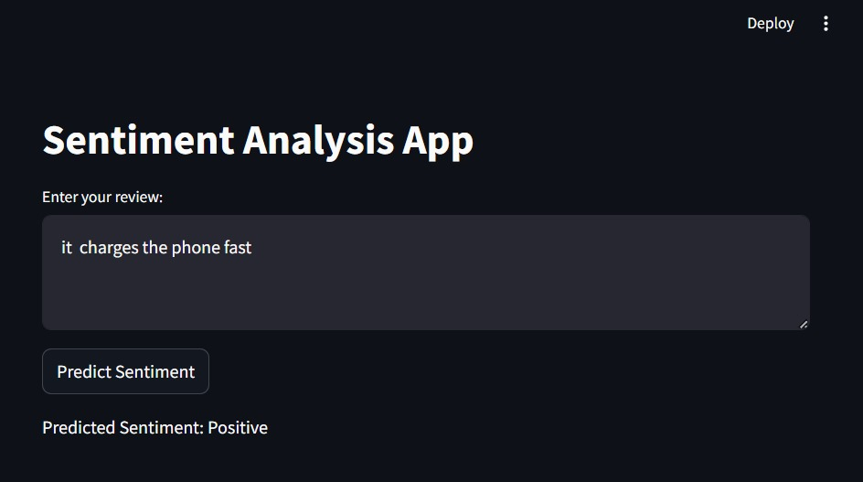

Slide 23
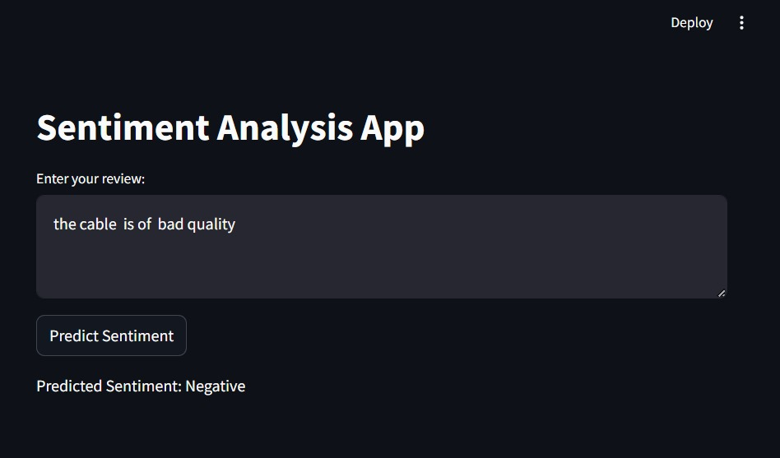

Slide 24
Challenges

Slide 25
Data collection using web scraping
Collecting customer reviews from eCommerce platforms can be challenging due to anti-scraping measures
Data pre processing
Cleaning emojis,un defined meaning less text Handling case sensitivity, stop words etc.
Imbalanced Data
This imbalance can lead to biased models that are skewed towards the majority class.

Slide 26
Model Selection
Choosing the right model for sentiment analysis (e.g., Logistic Regression, SVM, Random Forest) and tuning hyperparameters is crucial. Balancing model accuracy with interpretability and performance is a challenge.
Sentiment Classification
Accurately classifying reviews as positive, neutral, or negative requires advanced techniques to handle ambiguities in language (e.g., sarcasm, double negatives)
Deployment
Integrating the sentiment analysis model into a user-friendly platform (Streamlit) poses challenges in terms of user interaction, scalability, and real-time feedback capabilities.

Slide 27
Thank you

